Slide 1
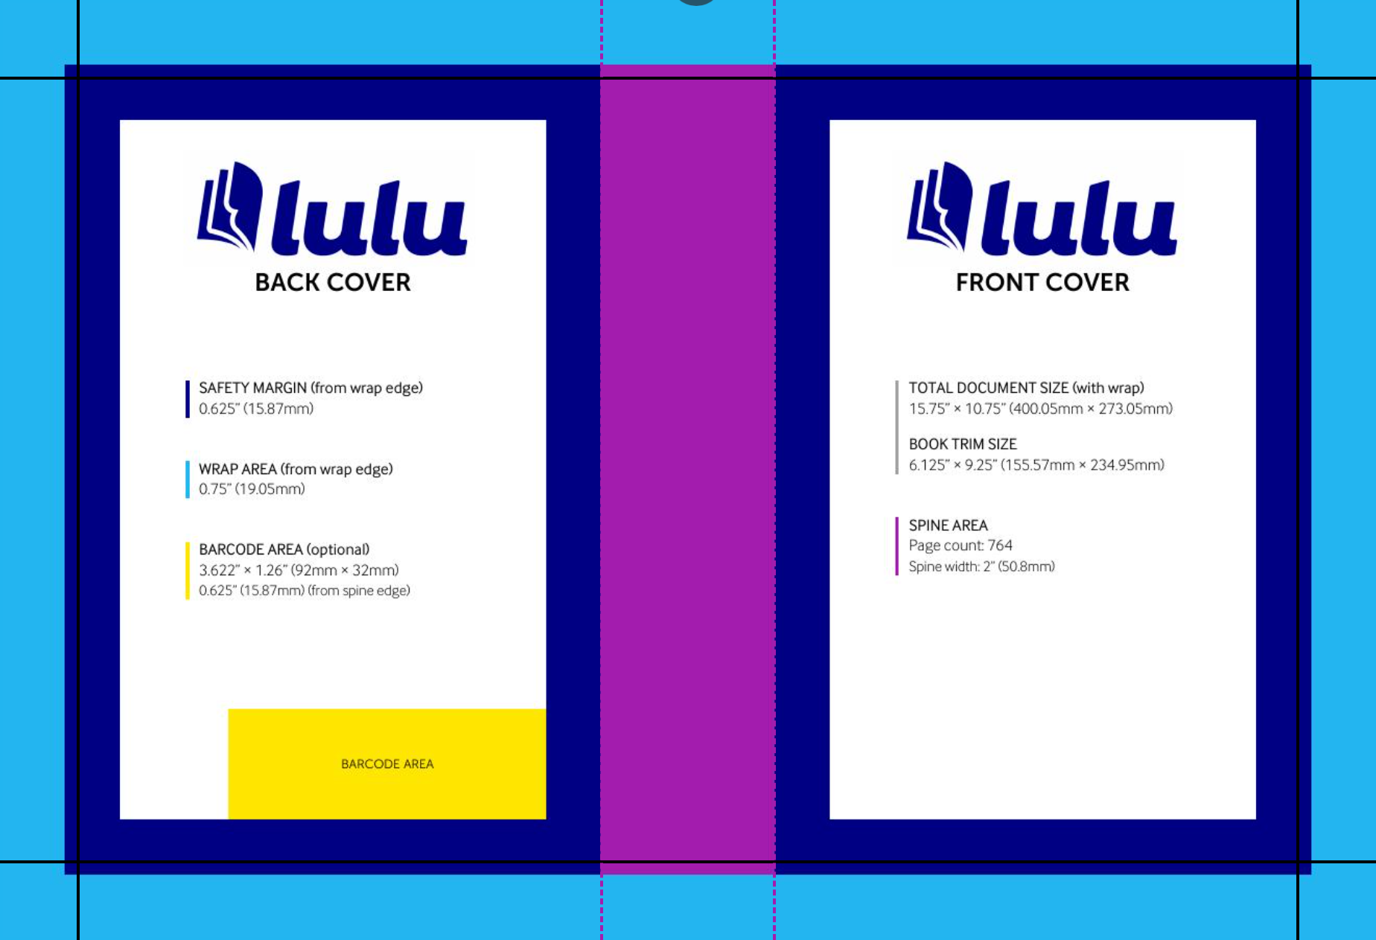

Slide 2
TRIM AREA
6” x 9”
SPINE AREA
2” x 10.75”
BODY AREA
4.875” x 8”
BODY AREA
4.875” x 8”
BODY AREA
4.875” x 8”
BARCODE AREA
92mm x 32mm
0.625”
Safety Margin Base = 0.5”
Safety Margin = 0.625”
Safety Margin Bleed = 0.125”
Wrap Margin = 0.75”
Notes:
Full Cover Dimensions
Total Height: 273.05 mm (10.75 in)
Total Width: 400.05 mm (15.75 in)

Slide 3

TRIM AREA
6” x 9”
SPINE AREA
2” x 10.75”
BODY AREA
4.875” x 8”
A Complete
Introduction to
ABSTRACT
ALGEBRA
1st Edition
Kan Onn Kit

Slide 4

A Complete
Introduction to
ABSTRACT
ALGEBRA
1st Edition
Kan Onn Kit

